Slide 1
Chapter 9: Using programming languages on z/OS

Slide 2

Chapter objectives
Be able to:
List several common programming languages for the mainframe
Explain the differences between a compiled language and an interpreted language
Create a simple CLIST or REXX program
Choose an appropriate data file organization for an online application
Compare the advantages of a high level language to those of Assembler language
Explain the relationship between a data set name, a DD name, and the file name within a program
Explain how the use of z/OS Language Environment affects the decisions made by the application designer

Slide 3
Key terms in this chapter
assembler
binder
compiler
debugging
dynamic link library
generation
I/O (input/output)
interpreter
load modules
pre-processor
programming language
variable

Slide 4
Overview of programming languages
Screenshot 1
A programming language is the way that a programmer instructs a computer to perform functions
Computers only understand machine language
Machine language is in binary form and, thus, very difficult to write
Humans write programs in a programming language, which is converted into machine language for the computer to process
There are many programming languages that have evolved from machine language
Notes:
A classification of computer languages follows.
1. Machine language, the 1st generation, direct machine code.
2. Assembler, 2nd generation, using mnemonics to present the instructions to be
translated later into machine language by an assembly program, such as Assembler
language. (z/OS High-Level Assembler)
3. Procedural languages, 3rd generation, also known as high level languages (HLL),
such as Pascal, FORTRAN, Algol, COBOL, PL/I, Basic, and C. The coded program,
called a source program, has to be translated via a compilation step. (Enterprise COBOL, Enterprise PL/I)
4. Non-procedural languages, 4th generation, also known as 4GL, used for predefined
functions in applications for databases, report generators, queries, such as RPG, CSP,
QMF™. (SQL for DB2 UDB for z/OS)
5. Visual Programming languages that use a mouse and icons, such as Visual Basic and
Visual C++.
6. Hypertext Markup Language, used for writing of World Wide Web documents. (HTML on z/OS)
7. Object-Oriented language, OO technology, such as Smalltalk, Java, and C++. (Java for z/OS; C/C++ for z/OS)
8. Other languages, for example 3D applications.

Slide 5
Classification of programming languages
1st generation
  Machine language
  specific to hardware and software
2nd generation
  Assembler language
  Specific to hardware
  Must be assembled
  Symbolic machine instructions plus data structures corresponding to machine storage and registers
Notes:
Assembler language programs are machine-dependent, because the language is a
symbolic version of the machine’s language on which the program is running. Assembler
language instructions can differ from one machine to another, so an Assembler language
program written for one machine might not be portable to another. Rather, it would most
likely need to be rewritten to use the instruction set of the other machine. A program
written in a high-level language (HLL) would run on other platforms, but it would need
to be recompiled into the machine language of the target platform.

Slide 6
Classification of programming languages (continued)
3rd generation
  Procedural languages, known as high-level languages (HLL)
  Example: COBOL
  Must be translated (compiled) before execution
  Usually portable (to an extent) across hardware and software platforms with a recompile
4th generation – 4GL
  Non-procedural languages
  Report generators
  Query languages
  Examples:
    RPG, CSP, QMF, SQL
Notes:
Most of the HLLs that we touch upon in this chapter are procedural languages. This type
is well-suited to writing structured programs. The non-procedural languages, such as
SQL and RPG, are more suited for special purposes, such as report generation.
Most HLLs are compiled into machine language, but some are interpreted. Those that are
compiled result in machine code which is very efficient for repeated executions.

Slide 7
Classification of programming languages (continued)
Visual programming languages (or event-driven languages)
  Visual Basic, Visual C++
Object-Oriented language
  used in OO technology, e.g. Smalltalk, Java, C++
Other languages
  3D applications
Scripting languages
  Perl
  REXX
  HTML
Notes:
Java is an object-oriented programming language developed by Sun Microsystems Inc.
Programming languages such as Enterprise COBOL and Enterprise PL/I in z/OS provide
interfaces to programs written in Java Language. Java can be used for developing
traditional zSeries commercial applications as well as Internet and intranet applications
that use standard interfaces.

Slide 8
Choosing a programming language for z/OS
Which language to use? Factors to consider include:
Response time requirements for the application
Budget allotted for development and ongoing support
Time constraints of the project
Whether subroutines will be coded in different languages
Whether to use a compiled or an interpreted language
Notes:
Lower-level languages (machine language, assemblers) are more difficult to code, debug, and update, but
run quickly and efficiently. Higher-level languages are easier to write code in, but can be less
efficient.
The available programmers might be skilled in some languages, but not others.
Interpreted languages must be parsed, interpreted, and executed each time that the
program is run. The trade-off for using interpreted languages is a decrease in programmer
time, but an increase in machine resources.

Slide 9
Using Assembler language on z/OS
Assembler language
  Not usually used for application development
  Machine-specific
Used when:
  Accessing bits or bytes
  Accessing system control blocks
  Execution efficiency is needed (performance)
  Require high performance subroutines that can be called from HLL programs
Notes:
Assembler language is made up of statements that represent either instructions or comments. The instruction statements are the working part of the language and are divided into the following three groups:
Machine instructions. A machine instruction is the symbolic representation of a machine language instruction of the following instruction sets:
IBM System/360
IBM System/370
IBM System/370 Extended Architecture (370-XA)
IBM Enterprise Systems Architecture/370 (ESA/370)
IBM Enterprise Systems Architecture/390 (ESA/390)
IBM z/Architecture
It is called a machine instruction because the assembler translates it into the machine language code that the computer can execute.
Assembler instructions. An assembler instruction is a request to the assembler to do certain operations during the assembly of a source module; for example, defining data constants, reserving storage areas, and defining the end of the source module.
Macro instructions. A macro instruction is a request to the assembler program to process a predefined sequence of instructions called a macro definition. From this definition, the assembler generates machine and assembler instructions, which it then processes as if they were part of the original input in the source module.

Slide 10
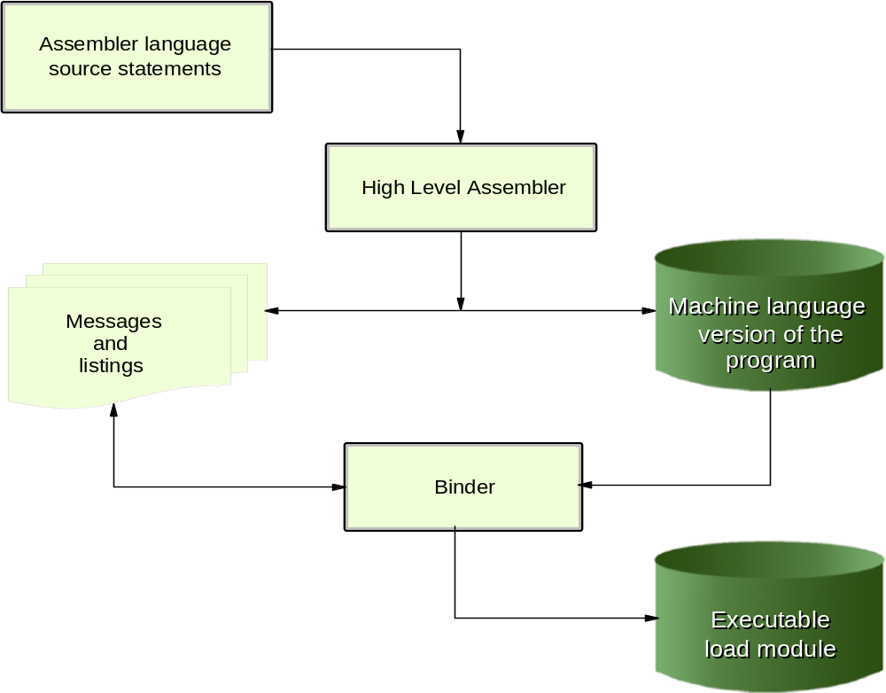
From Assembler source to executable module
Notes:
The assembler produces a program listing containing information that was generated during the various phases of the assembly process. It is really a compiler for Assembler language programs.
The assembler also produces information for other processors, such as a binder (or linker, for earlier releases of the operating system). Before the computer can execute your program, the object code has to be run through another process to resolve the addresses where instructions and data will be located. This process is called linkage-editing (or link-editing, for short) and is performed by the binder.
The binder or linkage editor uses information in the object modules to combine them into load modules. At program fetch time, the load module produced by the binder is loaded into virtual storage. After the program is loaded, it can be run.

Slide 11
Using COBOL on z/OS
COBOL is an English-like programming language
Used for business-oriented applications
Capabilities of IBM Enterprise COBOL for z/OS and OS/390
  Integrate COBOL applications into Web-oriented business processes
  Inter-operability with Java
  Parsing of data in XML and Unicode formats
Notes:
Common Business-Oriented Language (COBOL) is a programming language similar to English that is widely used to develop business-oriented applications in the area of commercial data processing. COBOL has been almost a generic term for computer programming in this kind of computer language. However, as used in this course, COBOL refers to the product IBM Enterprise COBOL for z/OS and OS/390.
In addition to the traditional characteristics provided by the COBOL language, this version of COBOL is capable, through COBOL functions, of integrating COBOL applications into Web-oriented business processes. With the capabilities of this release, applications developers can do the following:
Utilize new debugging functions in Debug Tool
Enable interoperability with Java when an application runs in an IMS Java dependent region
Simplify the componentization of COBOL programs and enable interoperability with Java components across distributed applications
Promote the exchange and usage of data in standardized formats including XML and Unicode
With Enterprise COBOL for z/OS and OS/390, COBOL and Java applications can interoperate in the e-business world.

Slide 12
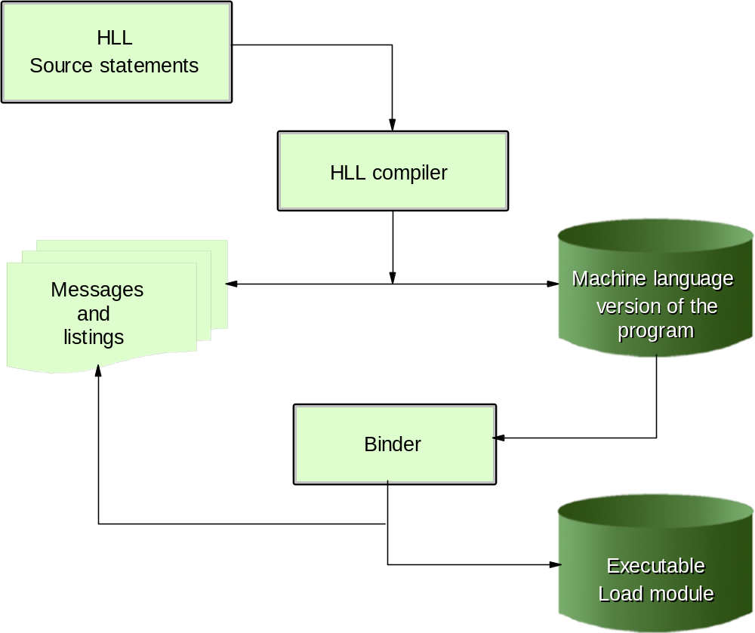
From HLL source to executable module
Notes:
The COBOL compiler produces a program listing containing all the information that it generated during the compilation. The compiler also produces information for other processors, such as the binder.
Before the computer can execute your program, the object code has to be run through another process in order to resolve the addresses where instructions and data will be located. This process is called linkage edition and is performed by the binder.
The binder uses information in the object modules to combine them into load modules. At program fetch time, the load module produced by the binder is loaded into virtual storage. When the program is loaded, it can then be run. This slide shows the process of translating the COBOL source language statements into an executable load module.
This process is similar to that of Assembler language programs. In fact, this same process is used for all of the HLLs that are compiled.

Slide 13
HLL relationship between JCL and program files
//MYJOB JOB
//STEP1 EXEC IGYWCLG
INPUT-OUTPUT SECTION.
FILE-CONTROL.
SELECT INPUT ASSIGN TO INPUT1 .....
SELECT DISKOUT ASSIGN TO OUTPUT1 ...
FILE SECTION.
FD INPUT1
BLOCK CONTAINS...
DATA RECORD IS RECORD-IN
01 INPUT-RECORD
...
FD OUTPUT1
DATA RECORD IS RECOUT
01 OUTPUT-RECORD
/*
//GO.INPUT1 DD DSN=MY.INPUT,DISP=SHR
//GO.OUTPUT1 DD DSN=MY.OUTPUT,DISP=OLD
Notes:
The slide shows an example of a COBOL compile, link and go job stream, showing the file program statements and the JCL statements to which they refer.
The COBOL SELECT statements make the link between the DDNAMEs INPUT1 and OUPUT1 and the COBOL FDs INPUT1 and OUPUT1 respectively. The COBOL FDs are associated with group items INPUT-RECORD and OUTPUT-RECORD.
The DD cards INPUT1 and OUTPUT1 are related to the data sets MY.INPUT and MY.OUTPUT respectively. The end result of this linkage in our example is that records read from the file INPUT1 will be read from the physical data set MY.INPUT and records written to the file OUTPUT1 will be written to the physical data set MY.OUTPUT.
The program is completely independent of the location of the data, the name of the data sets, etc.
Since the program does not make any reference to the physical data set, we would not need to recompile the program if the name of the data set or its location were to change.

Slide 14
HLL relationship between JCL and program (continued)
COBOL SELECT statement makes the link between the DDNAMEs INPUT1 and OUTPUT1 and the COBOL FDs INPUT1 and OUTPUT1 respectively
The COBOL FDs are associated with group items INPUT-RECORD and OUTPUT-RECORD
The program is completely independent of the location of the data or the name of the data sets.

Slide 15
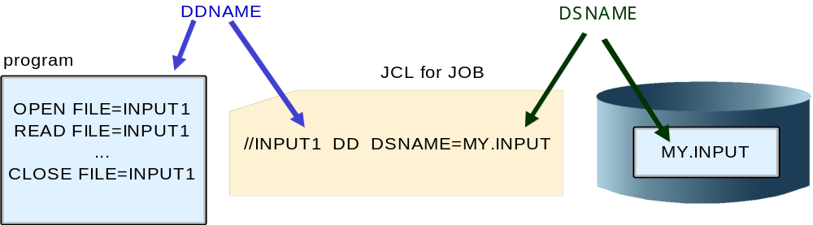
Relationship between JCL, program, and data set
Notes:
This diagram shows the relationship between the physical data set, the JCL and the program for Example on page. Once again, since the program does not make any reference to the physical data set, we would not need to recompile the program if the name of the data set or its location were to change.

Slide 16
Using PL/I on z/OS
Full-function, general-purpose high-level programming language
Suited for
  System programming
  Commercial
  Engineering/scientific, etc.
Less verbose than COBOL
Less English-like
Notes:
The process of compiling a PL/I source program and then link-editing the object code into a load module is basically the same as it is for COBOL.
The relationship between JCL and program files is the same for PL/I as it is for COBOL and other HLLs.

Slide 17
HLL relationship between JCL and program files
Referring to physical files by a symbolic file name is used by all of the HLLs
- even Assembler language
Isolates your program from changes to data set name and data set location
  data set name and location can change without recompiling program
“Hard-coding” data set names or other such information in a program is not usually considered a good programming practice
  Externalize these values from programs
Notes:
Values that are hard-coded in a
program are subject to change and would therefore require that the program be
recompiled each time a value changed. Externalizing these values from programs, as with
the case of referring to data sets within a program by a symbolic name, is a more
effective practice that allows the program to continue working even if the data set name
changes.

Slide 18
HLL relationship between JCL and program files
//MYJOB JOB
//STEP1 EXEC CLG
...
OPEN FILE=INPUT1
OPEN FILE=OUTPUT1
READ FILE=INPUT1
...
WRITE FILE=OUTPUT1
...
CLOSE FILE=INPUT1
CLOSE FILE=OUTPUT1
/*
//GO.INPUT1 DD DSN=MY.INPUT,DISP=SHR
//GO.OUTPUT1 DD DSN=MY.OUTPUT,DISP=OLD
Notes:
The technique of referring to physical files by a symbolic file name is not
restricted to COBOL; it is used by all HLLs and even in Assembler language. The
slide shows a generic HLL example of a program that references data sets through
symbolic file names.

Slide 19
Using C/C++ on z/OS
C is a multi-purpose programming language
Suited for:
  System-level code
  Text processing
  Graphics, etc.
C language contains concise set of statements, with functionality added through its library
C is highly consistent across different platforms
Notes:
The process of compiling a C source program and then link-editing the object code into a load module is basically the same as it is for COBOL.
The relationship between JCL and program files is the same for C as it is for COBOL and other HLLs.

Slide 20
Using Java on z/OS
Java is an object-oriented programming language
Enterprise COBOL and Enterprise PL/I provide interfaces to programs written in Java Language. Also, DB2 and IMS.
Java is pervasive across the zSeries platform.
Java Native Interface (JNI) allows your program to call programs written in other languages. The JNI is part of the Java Development Kit.
Notes:
Programming languages such as Enterprise COBOL and Enterprise PL/I in z/OS provide
interfaces to programs written in Java Language. Java can be used for developing
traditional zSeries commercial applications as well as Internet and intranet applications
that use standard interfaces.
The 64-Bit SDK package for z/OS, Java 2 Technology Edition V1.4, benefits application
developers who want to take advantage of the Java APIs for z/OS, write or run
applications across multiple platforms, or use Java to access zSeries data. Pure Java
applications that were previously storage constrained by 31-bit addressing should be able
to execute in a 64-bit environment.
In addition, some zSeries servers support a type of Java processor called the zSeries
Application Assist Processor (zAAP). Only Java workloads run on this processor type.
Programs can be run interactively through z/OS UNIX or in batch.

Slide 21
Using CLISTs on z/OS
CLIST (pronounced "see list") is short for command list, because the most basic CLISTs are lists of TSO/E commands
CLIST language is an interpreted language (that is, you don't have to compile and link-edit it)
CLISTs are easy to write and test
CLIST and REXX languages:
  Two command languages available in TSO/E
CLIST programming language is used for:
  Performing routine tasks (entering TSO/E commands)
  Invoking other CLISTs
  Invoking applications written in other languages
  ISPF applications (displaying panels, controlling application flow)
  One-time quick solutions to problems
Notes:
Like programs in other high-level interpreted languages, CLISTs are easy to write and test.
You do not compile or link-edit them. To test a CLIST, you simply run it and correct any errors
that might occur until the program runs without error.
A CLIST can perform a wide range of tasks. Three general categories of CLISTs are:
CLISTs that perform routine tasks
By grouping together in a CLIST the instructions required to
complete a task, you reduce the time, number of keystrokes, and errors involved in
performing the task; thus, you increase your productivity. Such a CLIST can consist of
TSO/E commands only, or a combination of TSO/E commands, JCL statements, or
CLIST statements.
CLISTs that are structured applications
Any CLIST can invoke another CLIST, which is referred to as a nested
CLIST. CLISTs can also contain separate routines called sub-procedures. Nested CLISTs
and sub-procedures let you separate your CLISTs into logical units and put common
functions in a single location.
CLISTs that manage applications written in other languages
You might have access to applications that are written in other programming languages.
However, the interfaces to these applications might not be easy to use or remember.
Rather than write new applications, you can write CLISTs that provide easy-to-use
interfaces between the user and such applications.
A CLIST can send messages to, and receive messages from, the terminal to determine
what the user wants to do. Then, based on this information, the CLIST can set up the
environment and issue the commands required to invoke the program that performs the
requested tasks.

Slide 22
Using REXX on z/OS
Restructured Extended Executor (REXX) language is a procedural language
REXX is an interpreted and compiled language
REXX is a more full-function language than CLIST
REXX can be used for:
  Performing routine tasks (entering TSO/E commands)
  Invoking other REXX execs
  Invoking applications written in other languages
  ISPF applications (displaying panels, controlling application flow)
  One-time quick solutions to problems
  System programming
  Anywhere that we might use another HLL compiled language
Notes:
The Restructured Extended Executor (REXX) language is a procedural language that
allows programs and algorithms to be written in a clear and structural way. It is an
interpreted and compiled language. An interpreted language is different from other
programming languages, such as COBOL, because it is not necessary to compile a
REXX command list before executing it. However, you can choose to compile a REXX
command list before executing it to reduce processing time.
A new dialect of REXX called NetRexx™ works seamlessly with Java. NetRexx programs can
use any Java classes directly, and can be used for writing any Java class. This brings Java
security and performance to REXX programs, and REXX arithmetic and simplicity to Java.
A single language, NetRexx, can be used for both scripting and application development.
The structure of a REXX program is simple. It provides a conventional selection of
control constructs. For example, these include IF... THEN... ELSE... for simple
conditional processing, SELECT... WHEN... OTHERWISE... END for selecting from a
number of alternatives, and several varieties of DO... END for grouping and repetitions.
No GOTO instruction is included, but a SIGNAL instruction is provided for abnormal
transfer of control such as error exits and computed branching.

Slide 23
Compiled versus interpreted languages
Compiled versus interpreted:
  A design-stage decision
  Performance is slower with interpreted languages
Both compiled and interpreted languages have their strengths and weaknesses
No simple answer as to which is better -- it depends on the application. Within a single application, we might decide to use several programming languages.
Notes:
During the design of an application, you might need to decide between using an compiled
language or an interpreted language for the application source code. Both types of
languages have their strengths and weaknesses. Usually, the decision to use an
interpreted language is based on time restrictions on development or for ease of future
changes to the program. A trade-off is made when using an interpreted language. You
trade speed of development for higher execution costs. Because each line of an
interpreted program must be translated each time it is executed, there is a higher
overhead. Thus, an interpreted language is generally more suited to ad hoc requests
versus non-ad hoc.

Slide 24
Advantages of compiled languages
Assembler, COBOL, PL/I, C/C++ are translated by running the source code through a compiler
This results in very efficient code that can be executed any number of times
Often, the overhead for the translation is incurred just once, when the source is compiled; thereafter, it need only be loaded and executed
Compiled programs will be more efficient and performing
Interpreted languages are often parsed, interpreted, and executed each time that the program is run, increasing the cost of running the program
Notes:
Assembler, COBOL, PL/I, C/C++ are all translated by running the source code through a
compiler. This results in very efficient code that can be executed any number of times.
The overhead for the translation is incurred just once, when the source is compiled;
thereafter, it need only be loaded and executed.

Slide 25
Advantages of interpreted languages
Screenshot 2
An interpretive language is relatively easy to code, test, and change
Good for one-time solutions
Good for developing application prototypes
Ad hoc versus fixed requests
Time saver for command strings that are entered repeatedly
Notes:
We can see that it would make sense to use a compiled language for
the intensive parts of an application (heavy resource usage), whereas interfaces (invoking
the application) and less-intensive parts could be written in an interpreted language. An
interpreted language might also be suited for ad hoc requests or even for prototyping an
application.

Slide 26
Overview of Language Environment
Goals of application development today:
  Modularize and share code
  Develop applications on a Web-based front end
z/OS Language Environment product provides a common environment for all conforming high-level language (HLL) products:
  Establishes a common language development and execution environment for application programmers on z/OS
  Consolidates in a common runtime library, function previously provided in individual library products eliminating the need to maintain separate language libraries
Notes:
With Language Environment, you can use one run-time environment for your
applications, regardless of the application's programming language or system resource
needs.
With Language Environment, and its ability to call one language from another, z/OS
application programmers can exploit the functions and features in each language.

Slide 27
Advantages of z/OS Language Environment
Establishes a common run-time environment for all participating HLLs
Combines essential run-time services, such as routines for run-time message handling, condition handling, and storage management
All of these services are available through a set of interfaces that are consistent across programming languages
You can use one run-time environment for your applications, regardless of the application's programming language or system resource needs
Your program can seamlessly call one language from another, to exploit the functions and features in each language
Notes:
Language Environment establishes a common run-time environment for all participating
HLLs. It combines essential run-time services, such as routines for run-time message
handling, condition handling, and storage management. These services are available
through a set of interfaces that are consistent across programming languages. The
application program can either call these interfaces directly, or use language-specific
services that call the interfaces.

Slide 28
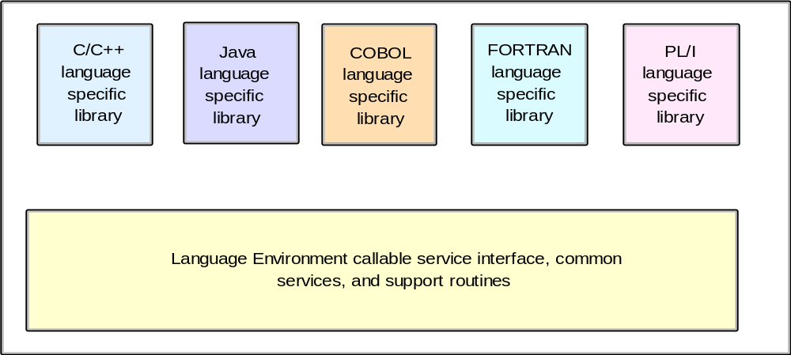
Language Environment components
Notes:
Language Environment consists of:
- Basic routines that support starting and stopping programs, allocating storage, communicating with programs written in different languages, and indicating and handling conditions
- Common library services, such as math services and date and time services, that are commonly needed by programs running on the system
- Language-specific portions of the run-time library

Slide 29
Summary
The mainframe supports most programming languages in use today.
Your choice of a programming language depends on several factors, including the requirements of the application and the installation’s ability to maintain the application.
Depending on the application requirements, you might use multiple languages or assembler subroutines for certain parts.
Remember: When it is time to update the application, other people must be able to program these languages as well.
Complexity in design must always be weighed against ease of maintenance.

